Slide 1
MSAS Tutorial Sequence -Module Four-
Written By Garrett Folbe

Slide 2

BACK AT IT

Slide 3
Goals of Today
Understand what Git is
Implement a system to keep your work uniform
Catch up from last time
Pandas overview
Reading from excel
Learn to manipulate DataFrames
Select specific rows
Select specific columns
Get some feedback!

Slide 4
Git is useful, but hard ☹
What is Git?
Git is a software used for version control
Used in some shape or form in every tech company
What is GitHub?
A company that provides hosting for software development
Users can create code repositories that can be used by others
Allows for collaboration and version control
Think about it like Google Drive without the real-time collaboration
What is GitBash?
Windows users only (although not exclusive)
A terminal that allows you to run linux commands (useful for git, especially)

Slide 5
Why do we use GitHub?
I am very familiar with it
Allows me to make my work accessible to the public
File storage is very easy
Good skill for everyone to have!

Slide 6
Let’s make our lives easier…
Delete all files you have already cloned and/or created related to this tutorial sequence
Open up your terminal
Run the command: cd ~/Desktop
Run the command: git clone https://github.com/gfolbe318/MSAS_tutorials.git
NEVER modify the folder you just cloned
For each week from now on, COPY the current module (entire folder) we are working on
Paste it somewhere you’d like to store your local files. This new copy can be modified

Slide 7
Review from last time

Slide 8



Pandas Welcome to REAL Data Science

Slide 9
Libraries in Python
A python library is a collection of functions that allows you to perform specific actions with your code
More often than not, a library is designed for a specific feature. There are libraries to…
Move and modify files on your computer
Create graphical interfaces for your code
Webscrape (more on that in the next module)
Perform data science operations ☺
And much more!
Libraries can be imported with the following syntax:
import library (imports entire library)
import library as lib (imports entire library as an alias, usually used to not clutter up code)
from library, import function a, b (imports functions a and b from the library, saves memory)
To access functions of your imported library, you will need to use the dot operator
We will see this throughout the module sequence

Slide 10
What is Pandas?
From their documentation:
“pandas is an open source, BSD-licensed library providing high-performance, easy-to-use data structures and data analysis tools for the Python programming language.”
Very powerful data science library
The basis of the rest of this module, as well as the next three!
Import pandas at the top of your jupyter notebok
import pandas as pd

Slide 11
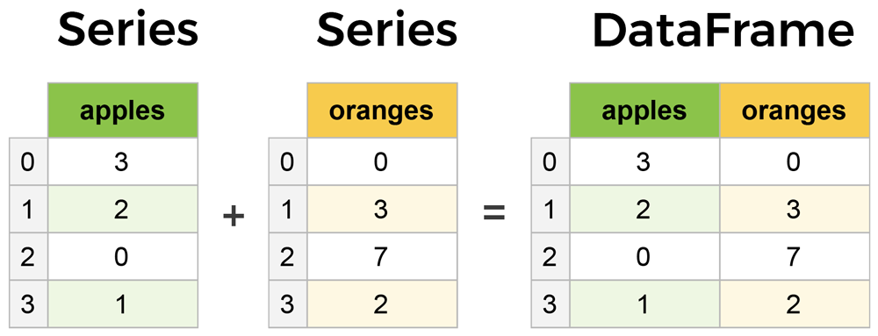
Series vs DataFrames
The primary two components of pandas are Series and DataFrames
Series is a column in your table, and a DataFrame is a multidimensional table comprised of a collection of Series

Slide 12
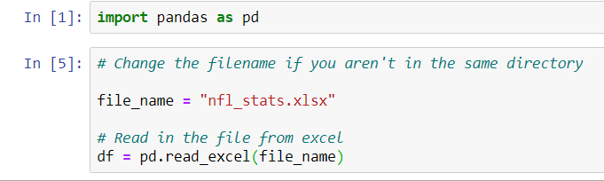
Reading in Files

Slide 13
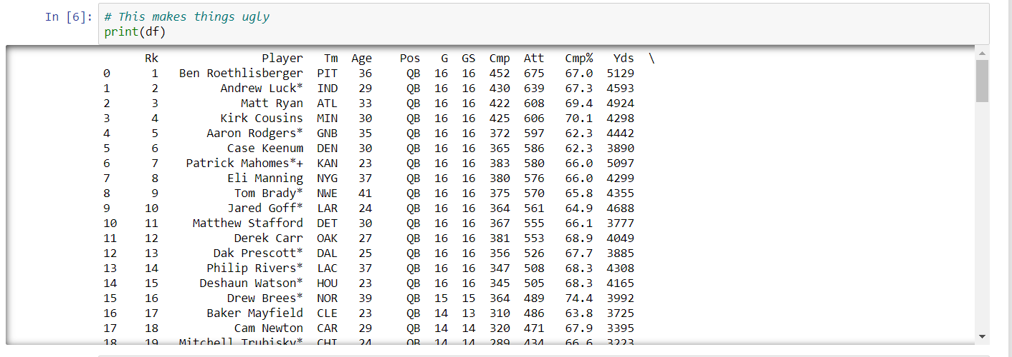
Printing a DataFrame

Slide 14
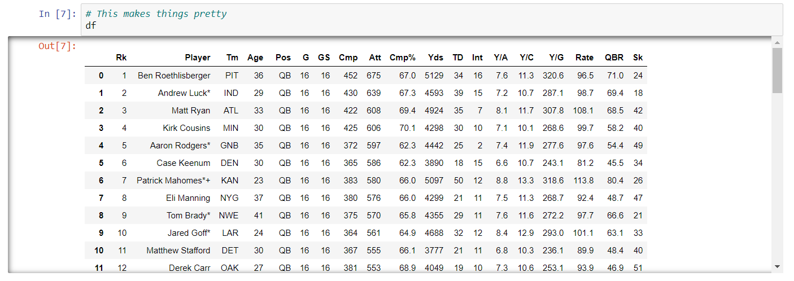
Displaying a DataFrame

Slide 15
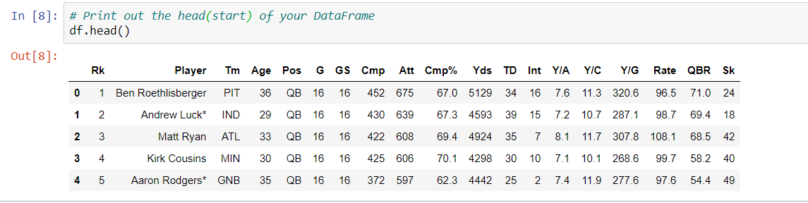
Displaying the head of a DataFrame

Slide 16
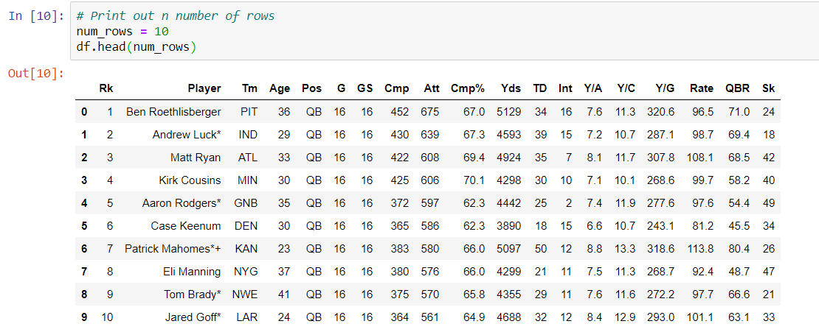
Display a Specific Number of Rows

Slide 17
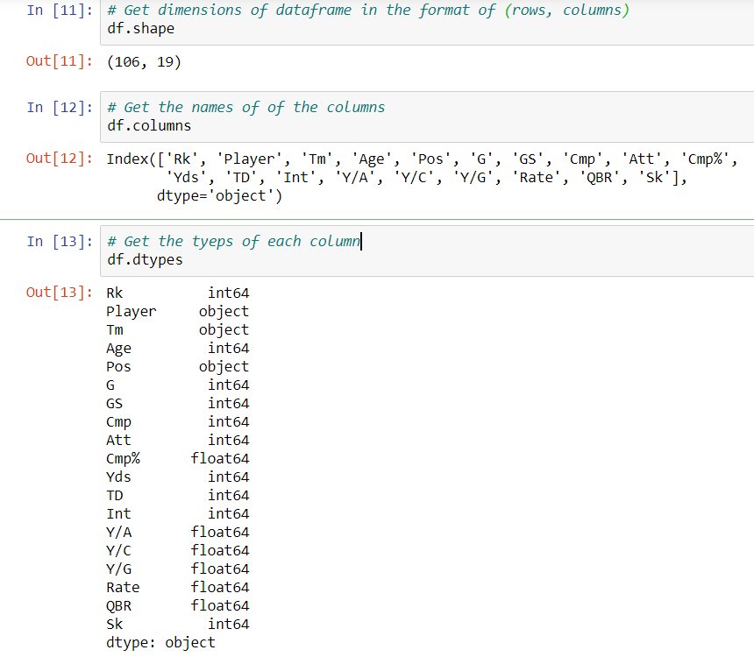
Get Information about the DataFrame

Slide 18
Let’s dive a little deeper
Extracting columns
Extracting rows
Modifying the table
Sorting values, deleting columns, renaming the index
Combining DataFrames

Slide 19
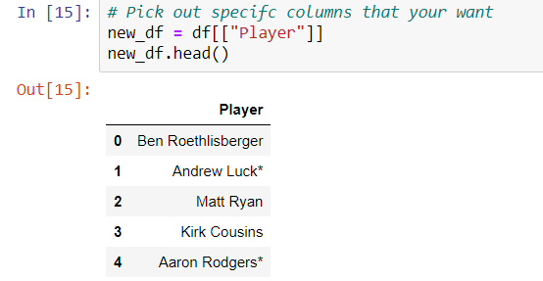
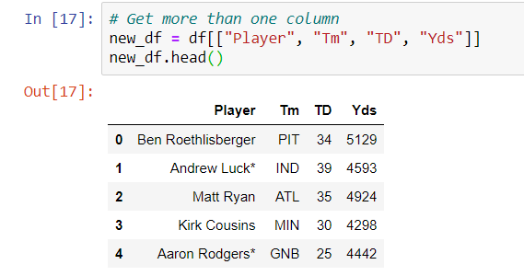
Extract Certain Columns

Slide 20
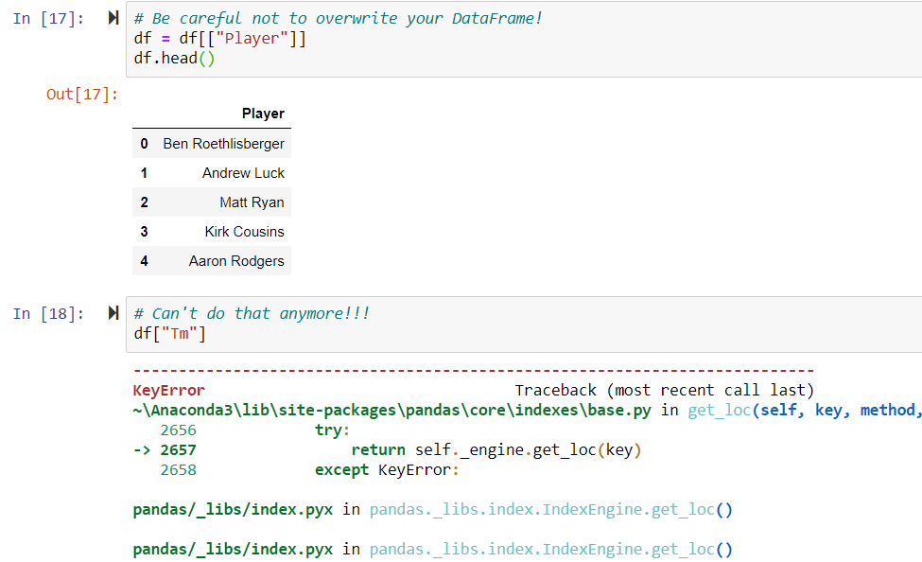
Be careful to not overwrite your DataFrame!
How do we undo this?
Re-read the table into the DataFrame (re-run the cell where it is declared)

Slide 21
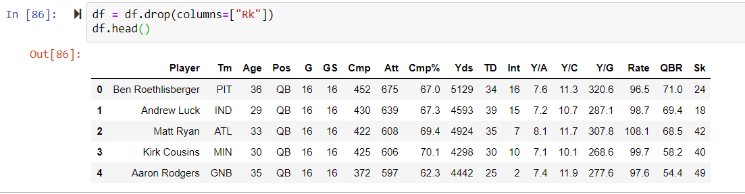
Delete a column

Slide 22
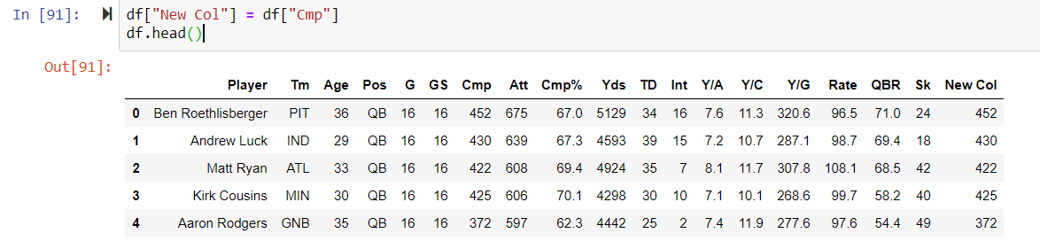
Create a new column!

Slide 23
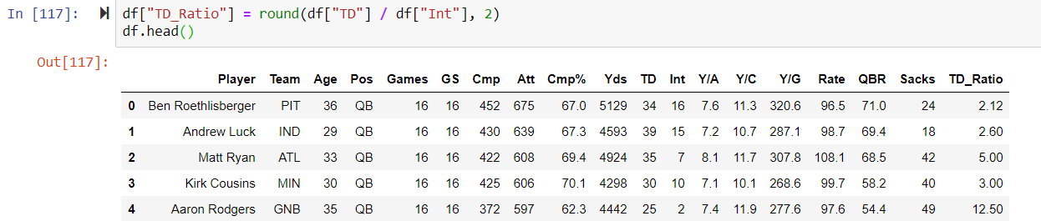
Create a new column using an operation

Slide 24
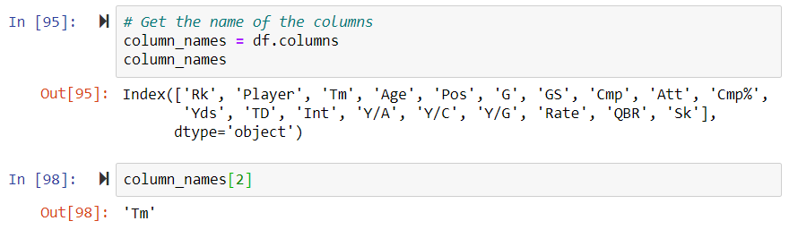
Changing column names

Slide 25
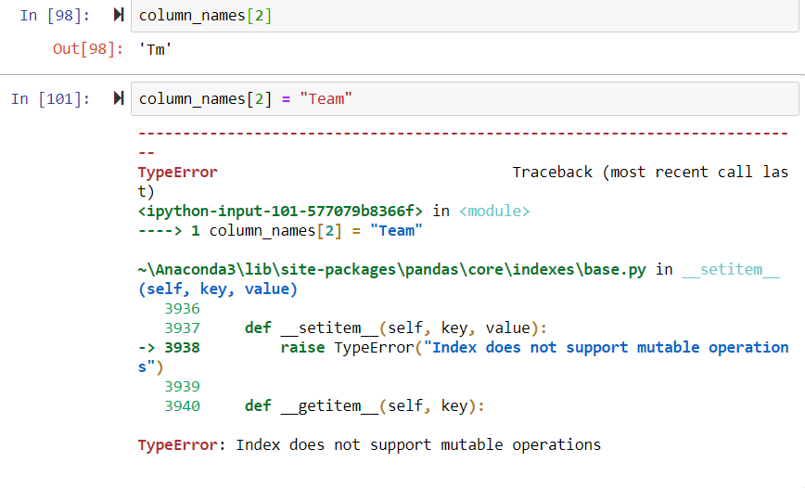
Not as easy as you’d think…

Slide 26
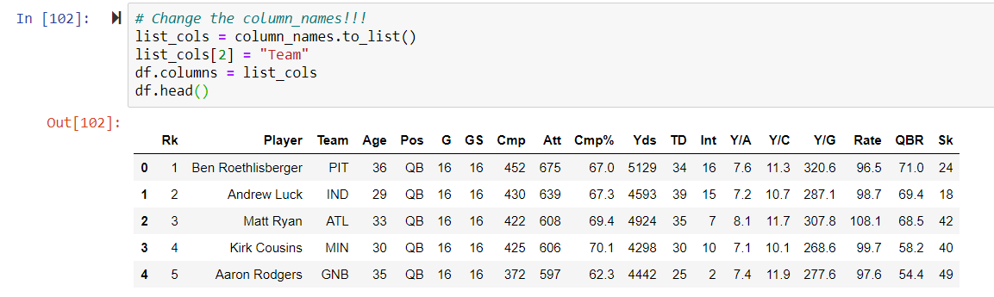
Way #1 – Beginner

Slide 27
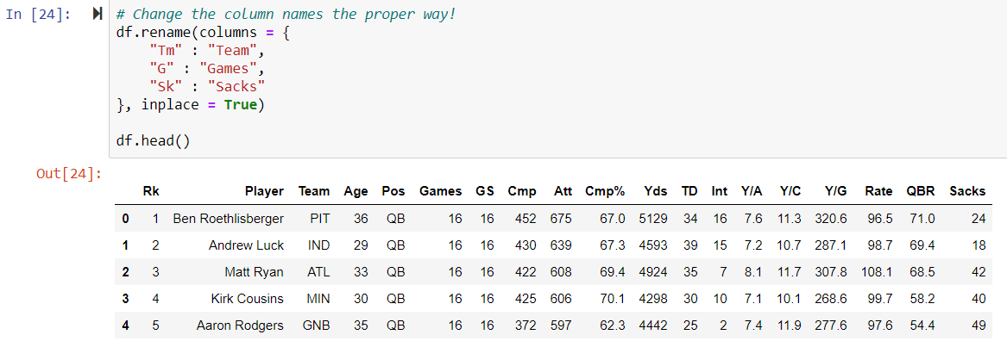
Way #2 – Advanced

Slide 28
Selecting rows
Now we'll look at getting data by rows.
For rows, we have two options:
.loc - locates by name
.iloc- locates by numerical index

Slide 29
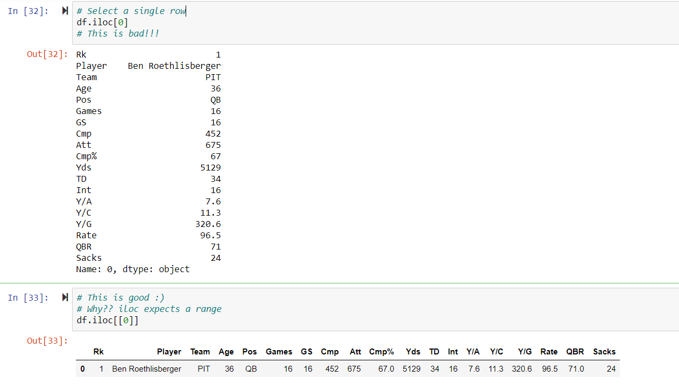
Selecting a single row using iloc

Slide 30
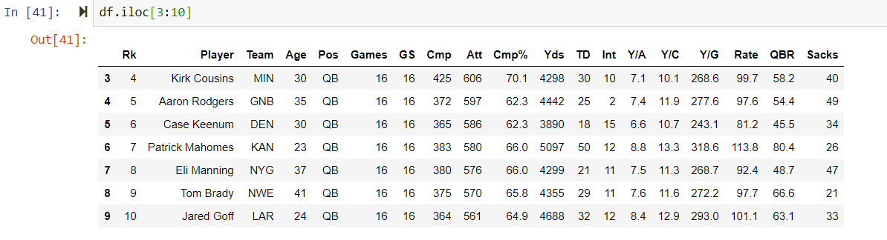
Selecting a range of rows using iloc

Slide 31
What is the “index” column?
The index column is how you access specific rows
The default will always be an increasing index unless it is set
Useful for ranges and determining order
Not much else
Why should we change the index??
Next slide

Slide 32
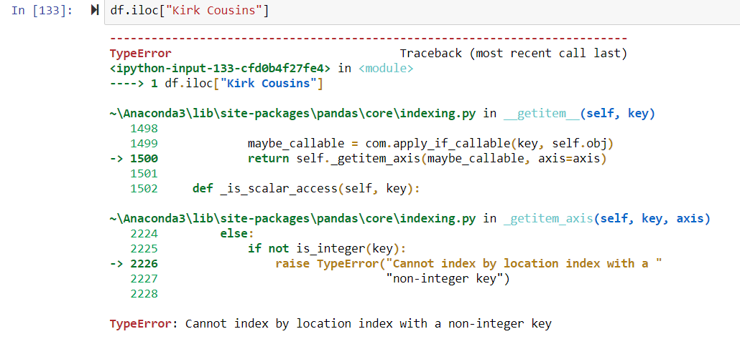
Example of a good time to change the index

Slide 33
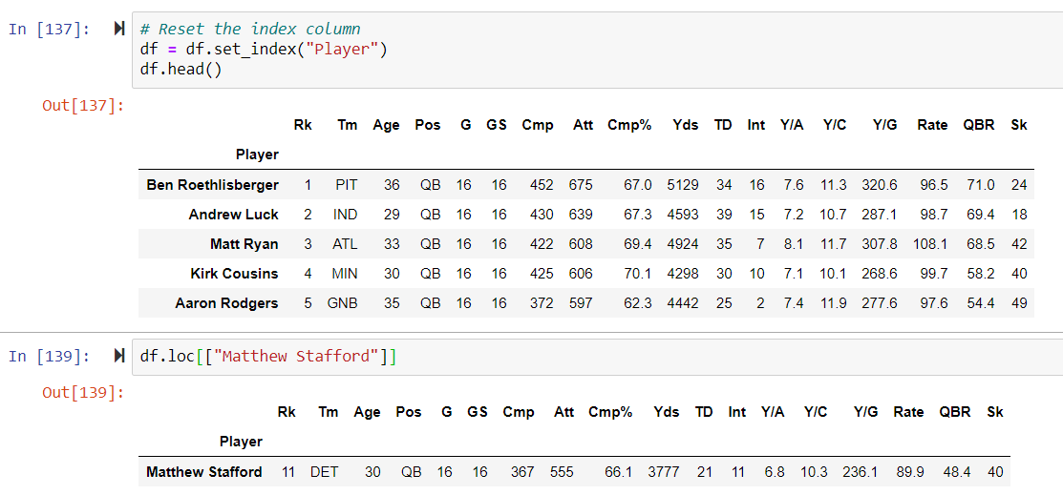
How to change the index

Slide 34
Selecting rows based on conditions
Basic operation that is extremely powerful
Allows you to view data based on criterion you want to view
Why is filtering useful?

Slide 35
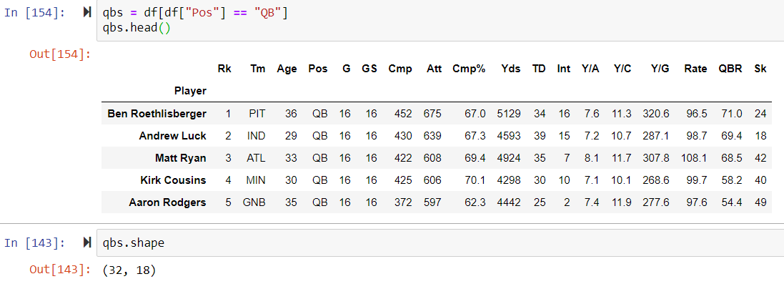
Filtering by one qualification

Slide 36
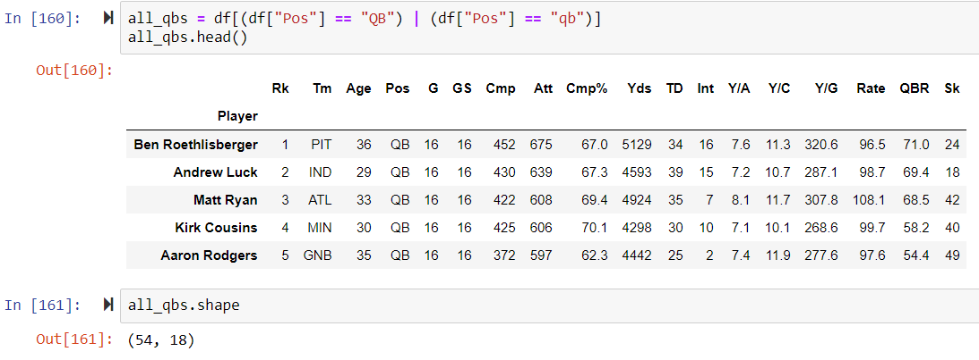
Filtering by multiple conditions

Slide 37
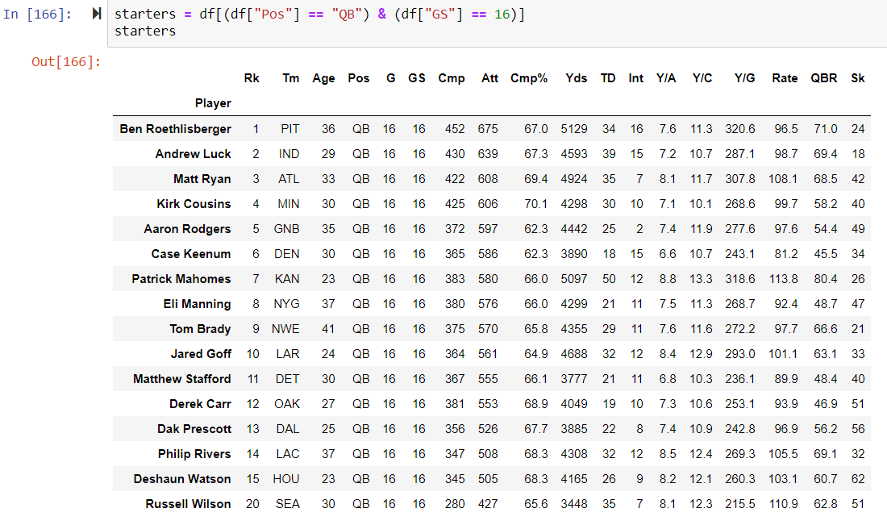
Additional Example – What does this show?

Slide 38
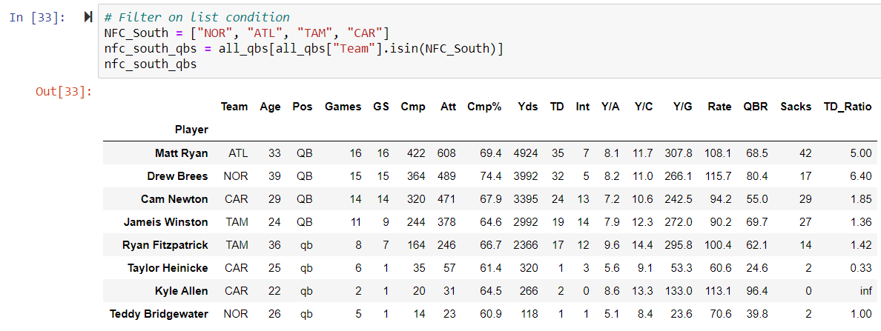
Check if element is in a list

Slide 39
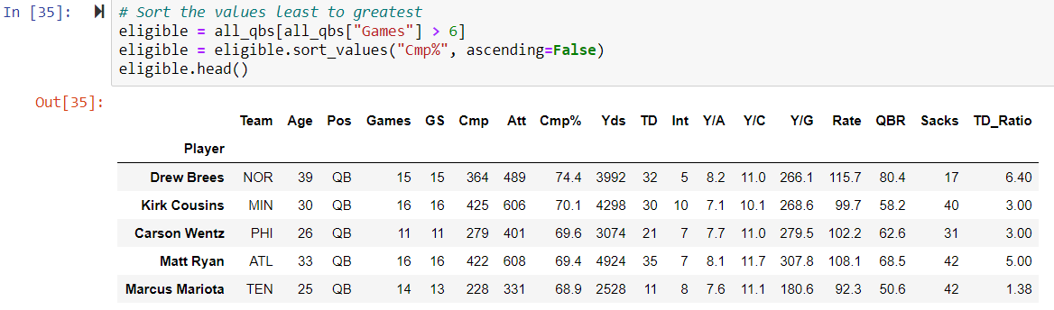
Sort Values

Slide 40
Tips for more efficient data manipulation
Never modify your original DataFrame in the middle of your notebook
Perform all cleaning operations in the beginning
Allows you to keep working linearly
Store modified tables in placeholder tables
Adding or deleting rows
Conditional filters
Use helpful names

